Slide 1
PSEA Priorities and Actions
Presentation for World Vison
6 November 2018
IASC AAP PSEA Task Team Coordinator
Tanya Axisa

Slide 2
A GLOBAL PRIORITY
Donors
DFID Safeguarding Summit; donor commitments: https://www.gov.uk/government/publications/donors-commitments-to-tackle-sexual-exploitation-and-abuse-and-sexual-harassment-in-the-international-aid-sector
NGOs
UK NGO Commitments: https://www.gov.uk/government/publications/uk-non-governmental-organisations-commitments-to-tackle-sexual-exploitation-and-abuse-and-sexual-harassment-in-the-international-aid-sector
Inter-Agency Misconduct Disclosure Scheme
UN
SGB Bulletin etc: https://www.un.org/preventing-sexual-exploitation-and-abuse/content/documents
UN SEA WG: https://www.un.org/preventing-sexual-exploitation-and-abuse/
UN Commitments: https://www.gov.uk/government/publications/united-nations-commitments-to-tackle-sexual-exploitation-and-abuse-and-sexual-harassment-in-the-international-aid-sector
IASC
AAP/PSEA Task Team: https://interagencystandingcommittee.org/accountability-affected-populations-including-protection-sexual-exploitation-and-abuse
PSEA Senior Focal Points
UNICEF PSEA/SH Championship
Notes:
Not going to go into detail but:
DFID: link to their commitments and others
BOND: 4 workstreams and commitments:
Accountability to people we work with
Organisational culture
The employment cycle
Reports and complaints mechanism
SCHR: Kate will explain later
NGO commitments: made at DFID Summit
UN:
SGB Bulletin – 2003 largely stands
UN SEA WG – led by OSC; including IP protocol
UN commitments
IASC: Restructuring; will have a new results group – Accountability and Inclusion; will include AAP, PSEA, SH
Task Team – aims to foster culture of COLLECTIVE AAP and PSEA
PSEA Senior Focal Points – first meeting was on 2 Nov – looked at PSEA country package
SFP led by UNICEF as Champion on PSEA/SH
Plus others: Global Ombuds, CHS etc

Slide 3
STATE OF PLAY
OUR ANALYSIS:
MOST ORGANISATIONS HAVE FEEDBACK/COMPLAINTS MECHANISMS IN PLACE
MOST ORGANISATIONS HAVE PSEA POLICIES AND PROCEDURES IN PLACE
BUT…….
Notes:
Evidence shows that most organisations have some kind of AAP mechanism in place and PSEA policies and procedures. We are basing this presentation on the assumption that WVI is one of them; so will not go into details on particular activities and systems….
However, happy to provide support here if there are identified gaps..
-

Slide 4
CHALLENGES AND GAPS?
Notes:
Evidence shows that most organisations have some kind of AAP mechanism in place and PSEA procedures but we consistently hear the following:
- Communities do not know about and do not use feedback and complaints mechanisms
- Communities do not always differentiate between who the perpetrators are
- Mechanisms on the ground are unable to deal with complaints of SEA
- Mechanisms on the ground do not know what to do with complaints about other organisations

Slide 5
SOLUTIONS/ACTIONS?
1. COLLECTIVE SYSTEMS
Why?
Communities can complain about anything and anyone and it will be dealt with
Organisations will know how to refer complaints against other organisations
More likely that serious complaints will be acted upon and organisations supported (with investigatory capacity etc)
What?
Common or coordinated feedback and complaints mechanisms
In-country PSEA networks with SOPs for referrals to other agencies
How?
Have a PSEA focal point in every country
Join in-country PSEA Networks
Contribute to collective AAP/CBCM mechanisms
Notes:
From our perspective there are some ways in which we can work together to change this. Will focus on 2 areas: the need to contribute to collective systems and the need to better link AAP and PSEA activities.
This is not to say that other areas (e.g. boosting investigatory capacity etc) are not important; but for the purposes of this presentation; this will be the focus in terms of potential solutions.

Slide 6
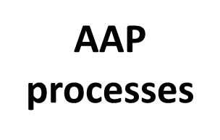
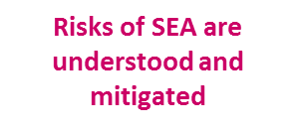
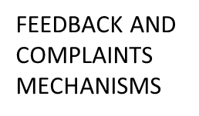
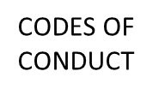
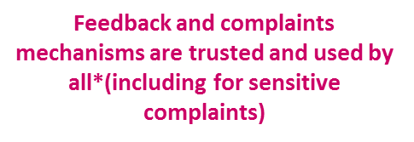
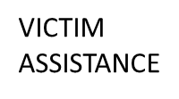
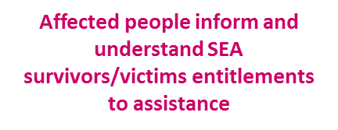
2. LINKING AAP and PSEA
Notes:
Underlying everything we have talked about is the critical need to link AAP and PSEA.
Talk about AAP processes; then PSEA processes and then show the results of collaboration between the 2.
Main point: PSEA – very internally facing processes; AAP – very community based.
Who are we trying to safeguard? Our organisations or the communities? Need to link the PSEA to the AAP to make sure affected people are at the heart…

Slide 7
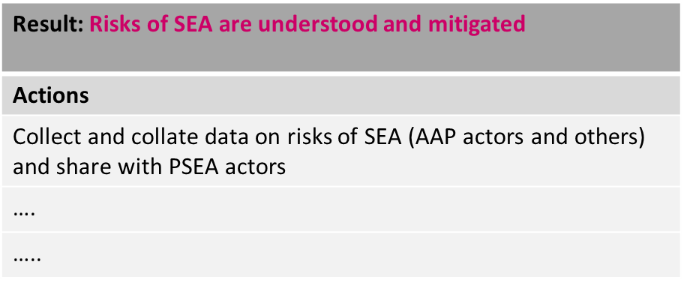
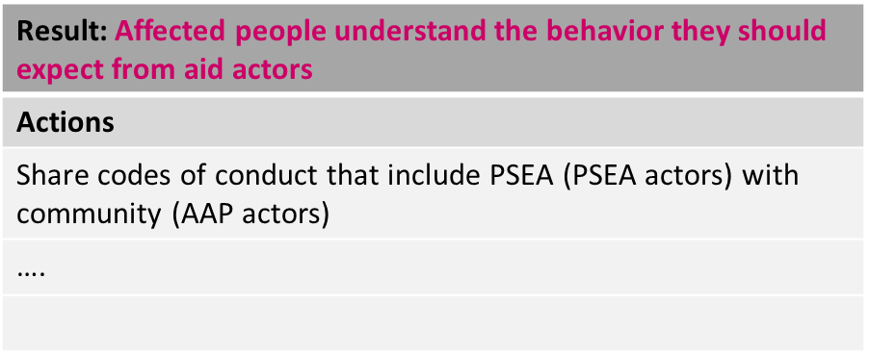
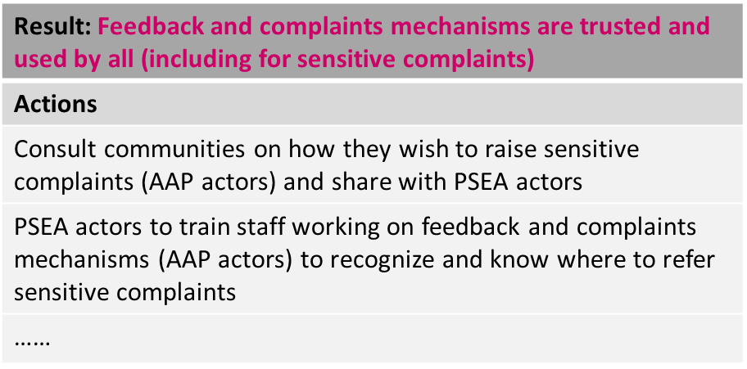
Examples of Collaborative AAP and PSEA Actions:
Notes:
In the Task Team we are working on this at the moment; there will be a finished 2 pager with the results and recommended actions.
But for now some examples

Slide 8
SUMMARY
ORGANISATION LEVEL:
Important to make both AAP and PSEA systems more robust
Navigate the global policy developments and adapt internal procedures (esp PSEA)
Make the appropriate links between AAP and PSEA to ensure affected people are at the heart of all PSEA work
AND:
Where possible, contribute to COLLECTIVE AAP and PSEA initiatives
Notes:
And on the a final note; the Task Team will be able to help with any of this….

Slide 9
QUESTIONS?

