Slide 1
Notebooks

Slide 2
Mugs

Slide 3
Folders

Slide 4
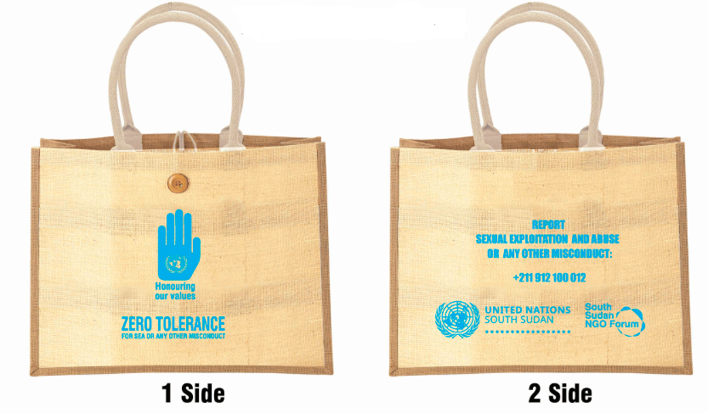
Jute Bags

Slide 5
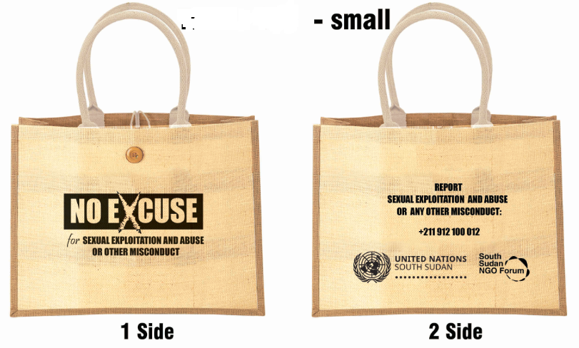
Jute bags - small

Slide 6
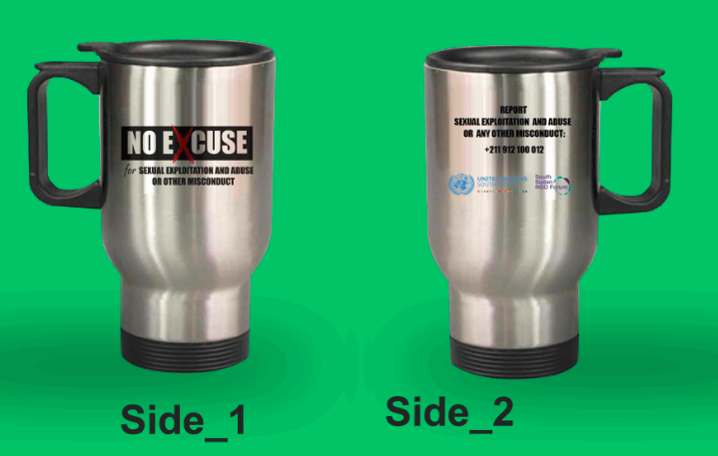
Thermo mugs

Slide 7
Stickers

Slide 8
Pens

Slide 9
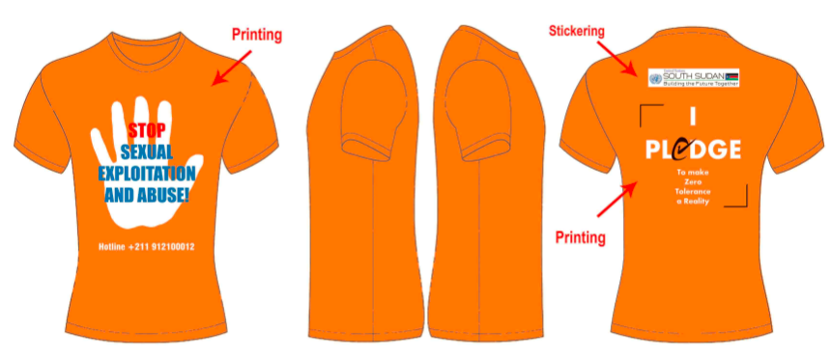
T-Shirts

Slide 10
T-Shirts

