Slide 1
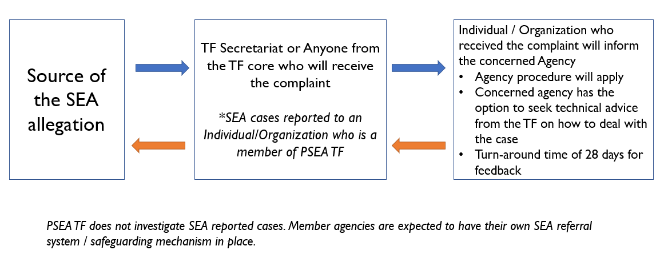
Referral Pathway: PSEA TF Philippines

